Slide 1
EDU-SOLUTIONS
REFERENCE MANUAL

Slide 2
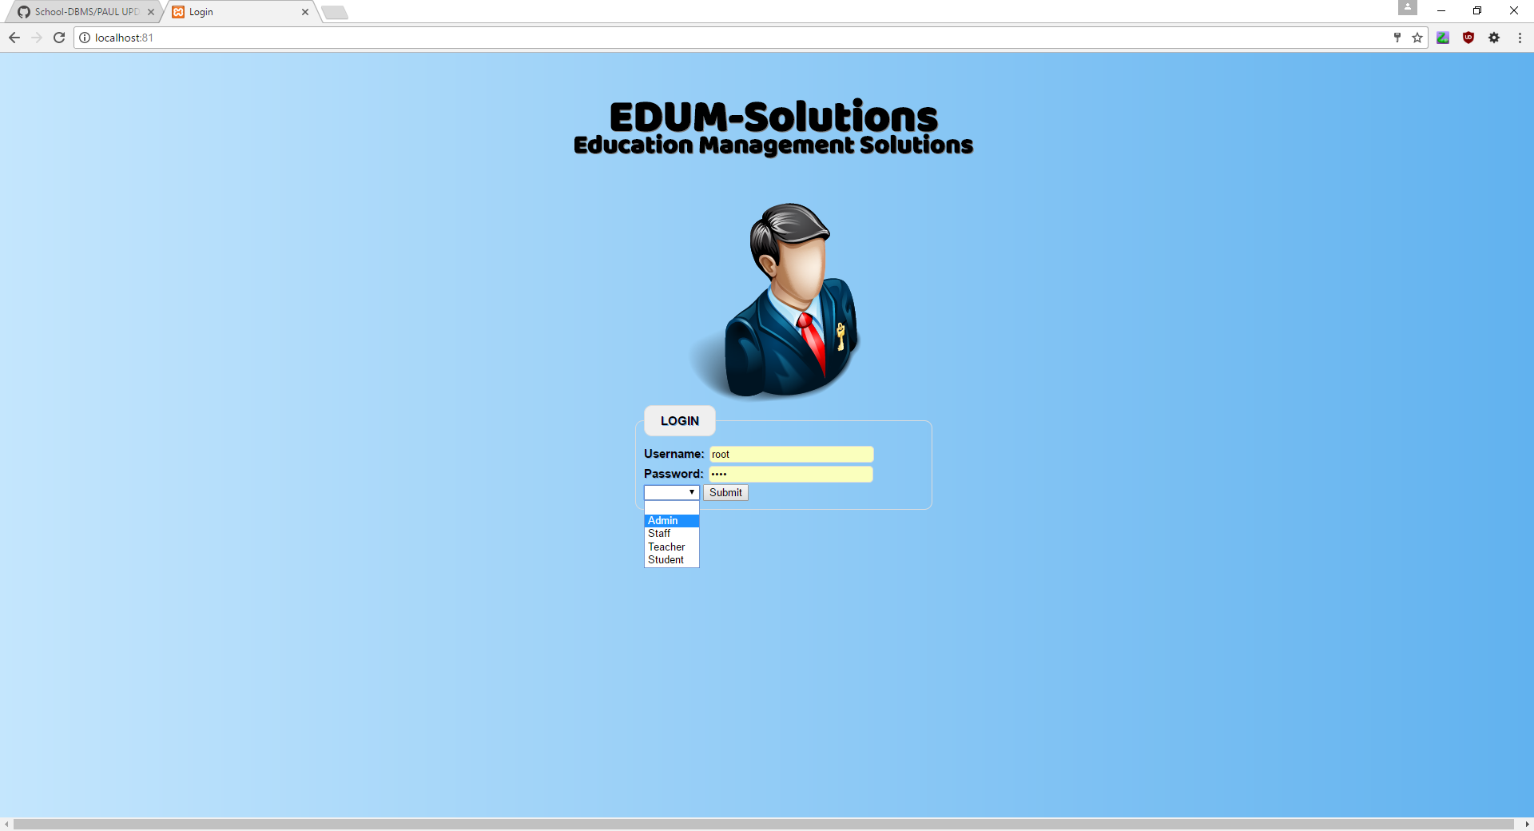
Choosing a user
You can select the type of user you wish to login as

Slide 3
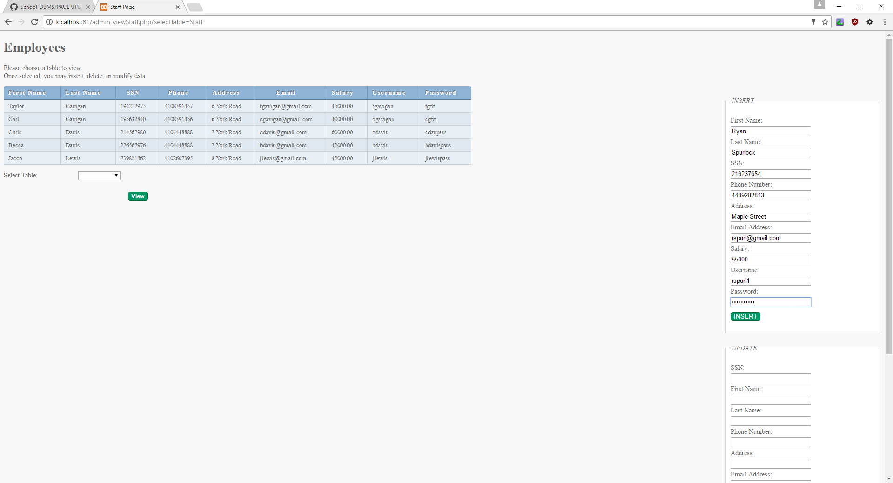
ADMIN
INSERTING NEW INFORMATION

Slide 4
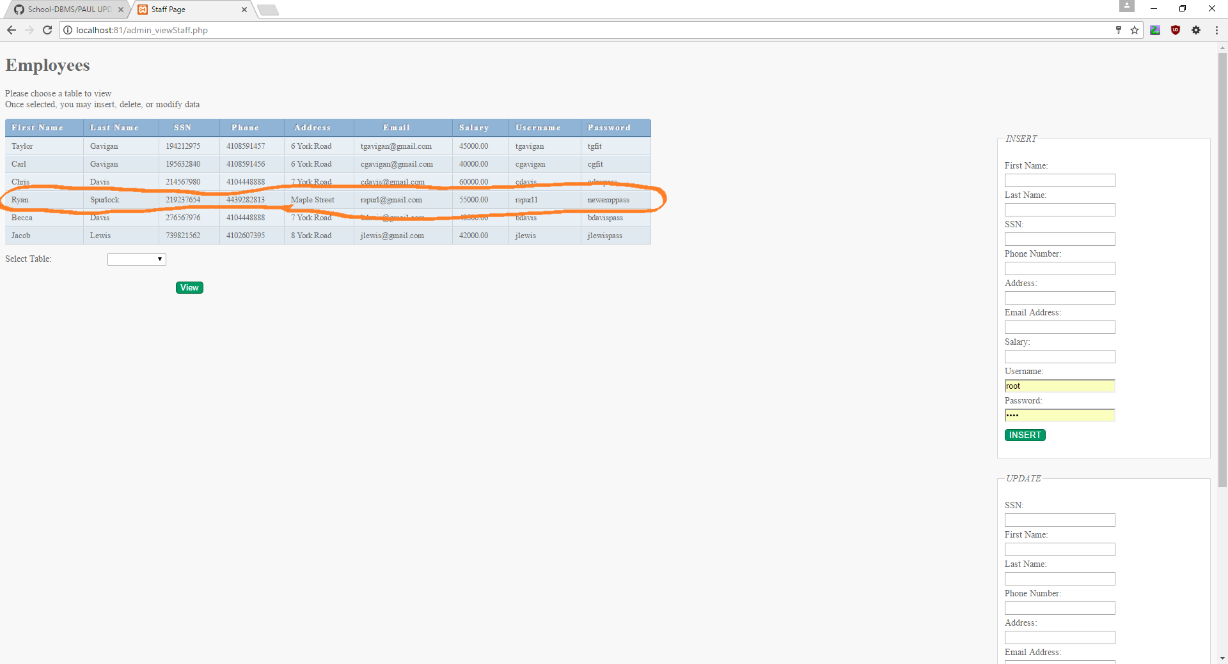

Slide 5
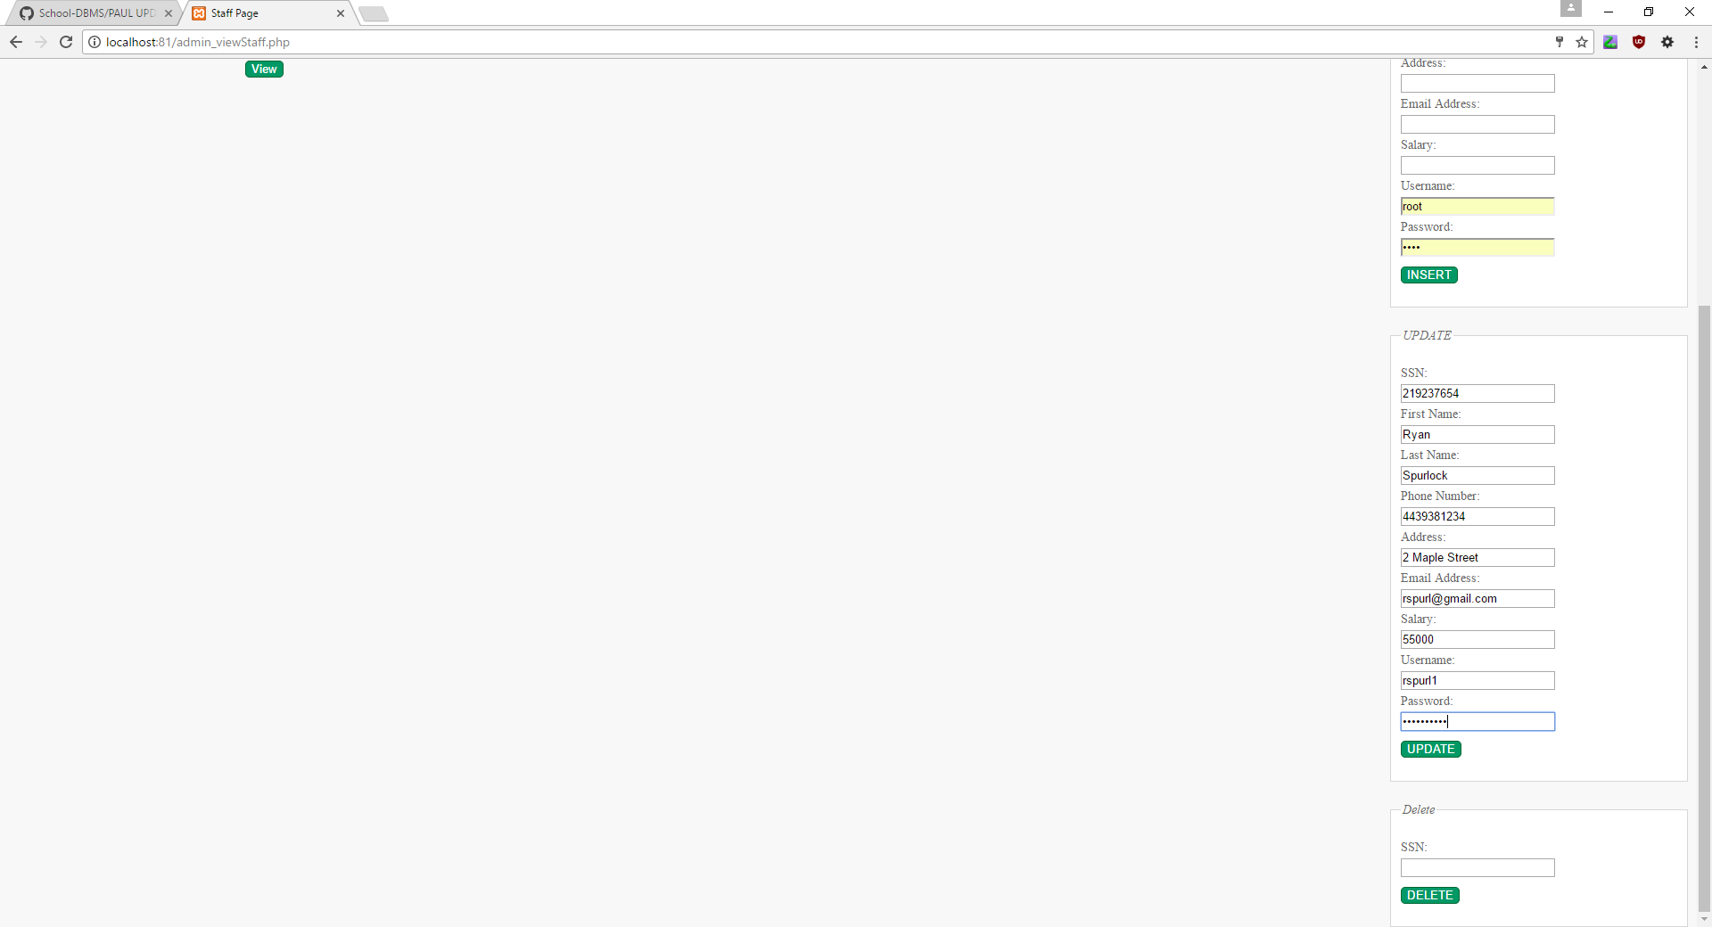
admin
Updating information

Slide 6
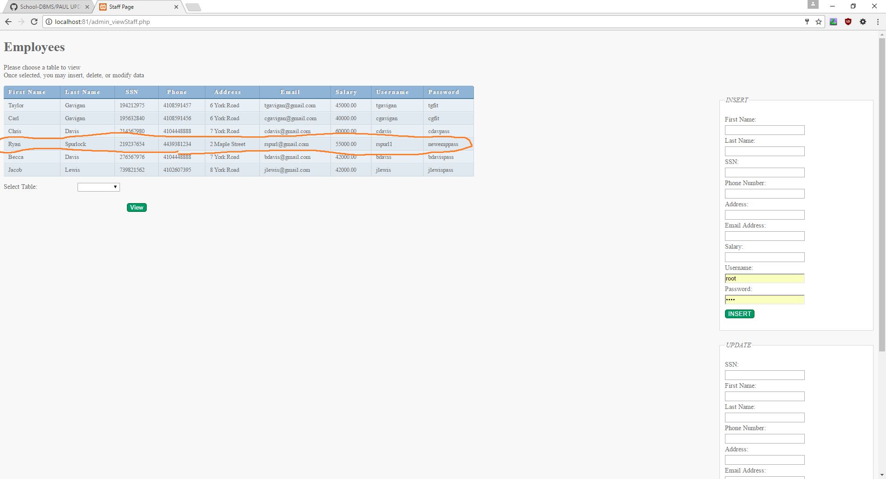

Slide 7
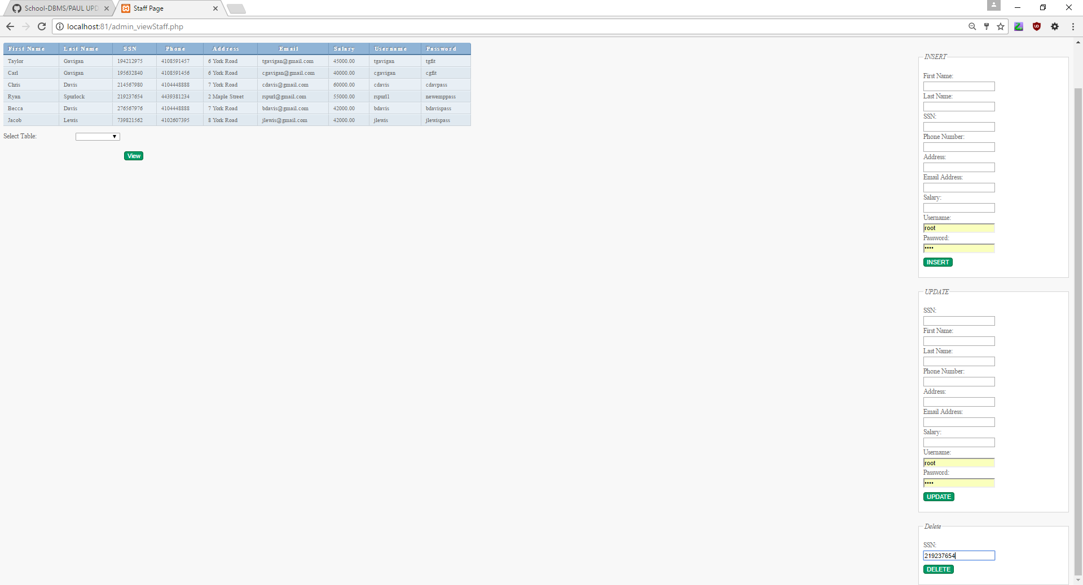
Admin
Deleting an entry (Page shrink to fit entire screen)

Slide 8
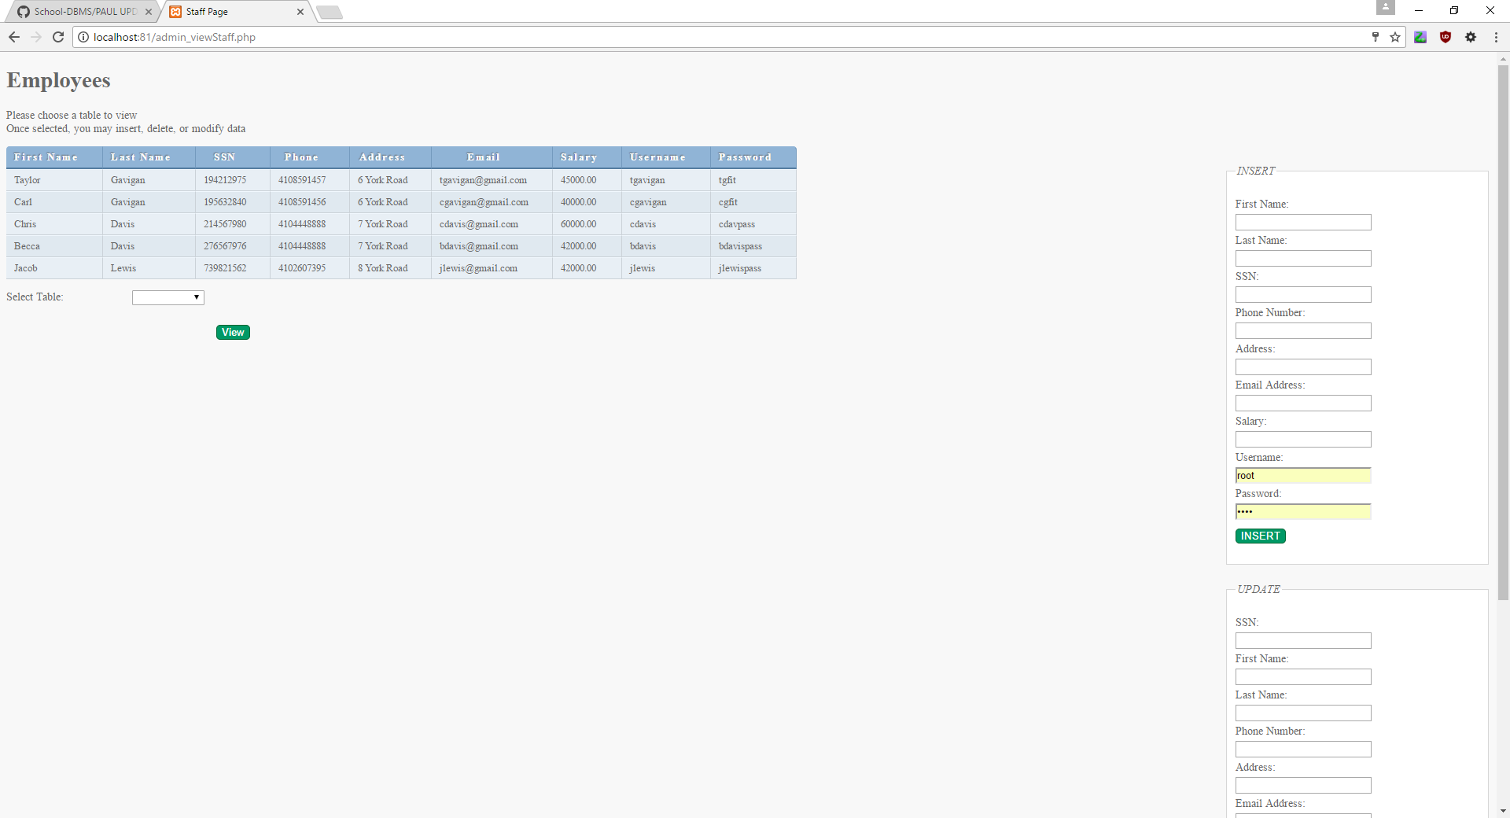

Slide 9
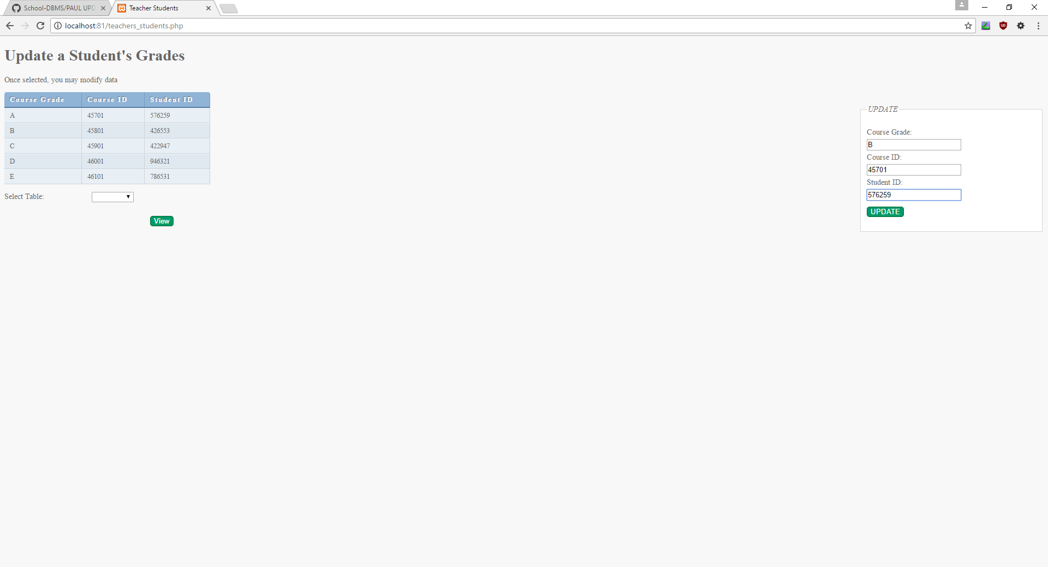
Teacher
Update Student’s Grades

Slide 10


Slide 11
Full demo
Full demo as well as how to set up the website can be found on the Tutorial_DEMO.pptx
Admins can view tables related to any user.
Admins can insert, update, and delete any table.
Teachers can view grades, other teachers, and update student’s grades.
Employees can only view limited information on other employees.

